Slide 1


Nguyễn Đình Pháp
1/11/2024

Slide 2

Outline
Executive Summary
Introduction
Methodology
Results
Conclusion
Appendix

Slide 3
Executive Summary
• Summary of methodologies
• Data collection
• Data wrangling
• EDA with data visualization
• EDA with SQL
• Building an interactive map with Folium
Building a Dashboard with Plotly Dash
• Predictive analysis
• Summary of all results
• Attributes correlate with successful landings.
• Exploratory data analysis results
• Machine Learning models on SpaceX data

Slide 4
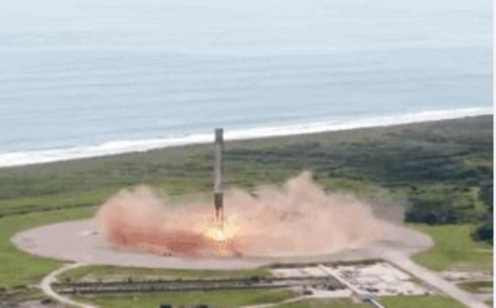
Introduction
The space industry has experienced a remarkable transformation in recent years, driven by innovative private enterprises like SpaceX, which has emerged as a frontrunner in this new era
• By developing the Falcon 9 rocket, SpaceX has successfully lowered launch costs significantly, thanks to its ability to land and reuse the first stage.
• Falcon 9 rocket at a cost of $62 million; other providers cost upward of $165 million each.

Slide 5

Section 1

Slide 6
Methodology
Executive Summary
Data collection methodology:
• SpaceX’s public API to gather data about launches.
• Web scraping from wiki pages.
Perform Data Wrangling
• Preparing the dataset for analysis by standardizing and converting relevant attributes.
• The data collected (JSON object and HTML tables) was converted into Pandas dataframe for visualization and analysis.
Perform exploratory data analysis (EDA) using visualization and SQL
Perform interactive visual analytics using Folium and Plotly Dash
Perform predictive analysis using classification models
Use of machine learning to determine if the first stage of Falcon 9 will land succesfully

Slide 7
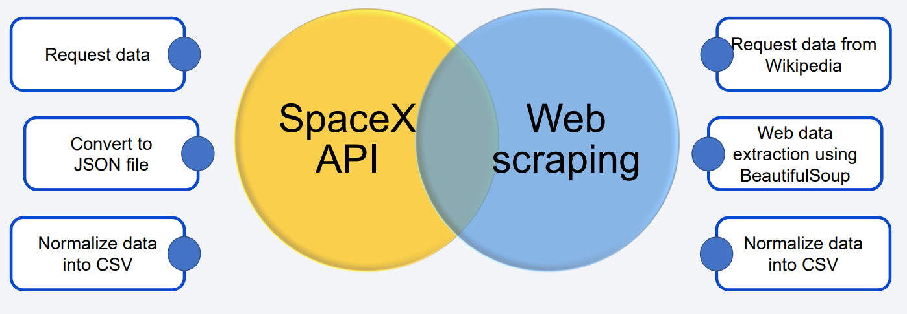
Data Collection

Slide 8
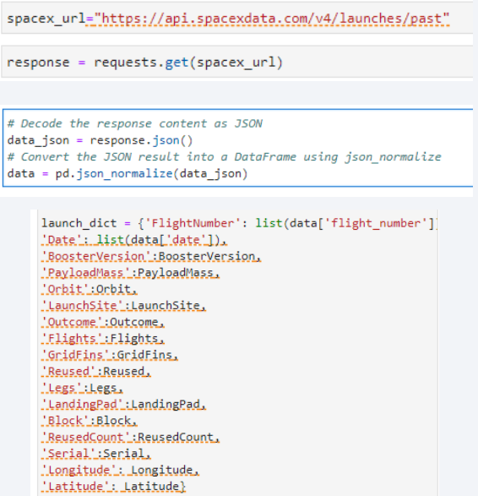
Data Collection – SpaceX API
Import libraries
• SpaceX API for data retrival
• use the GET method to retrieve data.
•Data processing
• Capture the response from the API, which will be in JSON format.
• Convert JSON response to DataFrame.
• Clean data and apply getBoosterVersion function
• Filter to only include Falcon 9 and dealing with missig values
• Exporting to a CSV
https://github.com/Meiluv/phap
Place your flowchart of SpaceX API calls here

Slide 9
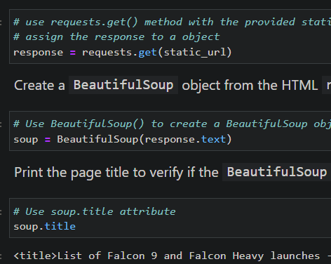
Data Collection - Scraping
• Import libraries
• Wikipedia data retrival
• Make an HTTP request to the URL for Falcon 9 launches.
• Create BeutifulSoup objet from HTML response
• Extract data
• Finding all tables
• Extract column names
• Create dictionary
• Store data in dictionary
• Convert the dictionary into a Pandas DataFrame
https://github.com/Meiluv/phap
Place your flowchart of web scraping here

Slide 10
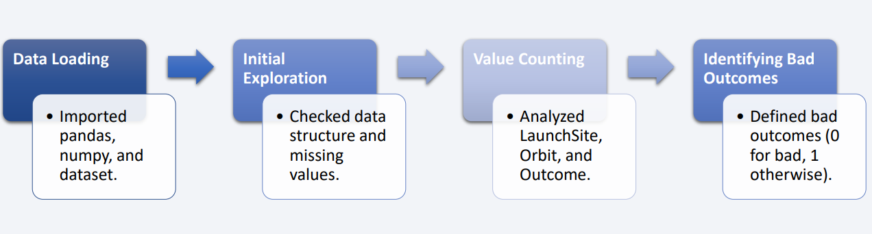
Data Wrangling
Preparing the dataset for analysis by standardizing and converting relevant attributes, especially the outcome variable

Slide 11
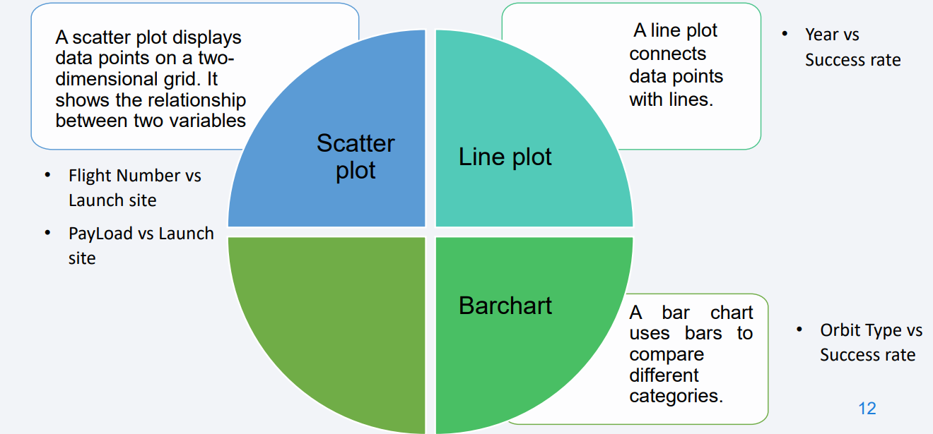
EDA with Data Visualization
https://github.com/Meiluv/phap

Slide 12
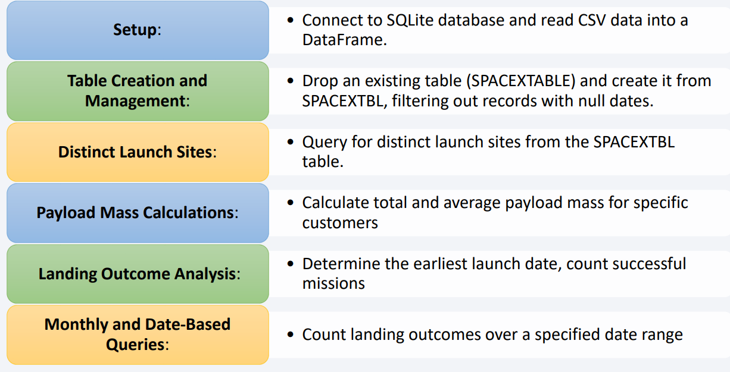
EDA with SQL
https://github.com/Meiluv/phap

Slide 13
Build an Interactive Map with Folium
• Using FOLIUM for Launch site analysis for SpaceX launch dataset
• Finding an optimal location for building a launch site
• In a Folium map, you can create various map objects:
• Markers: pinpoint specific locations points of interest, or data collection sites.
• Mark all launch sites on a map
• Mark the success/failed launches for each site on the map
• Circles: represent areas of interest or influence
• Lines (PolyLines): show paths, routes, or connections between different locations.
• Calculate the distances between a launch site to its proximities.
• Using Folium provided valuable insights into the spatial distribution of launch sites.

Slide 14
Build a Dashboard with Plotly Dash
Pie chart
Distribution of successful first stage landings between all sites
Distribution of successful and failed first stage landings for a selected site
Scatterplot:
Distribution of first stage landings split by payload mass, mission outcome and by booster version category
https://github.com/Meiluv/phap

Slide 15
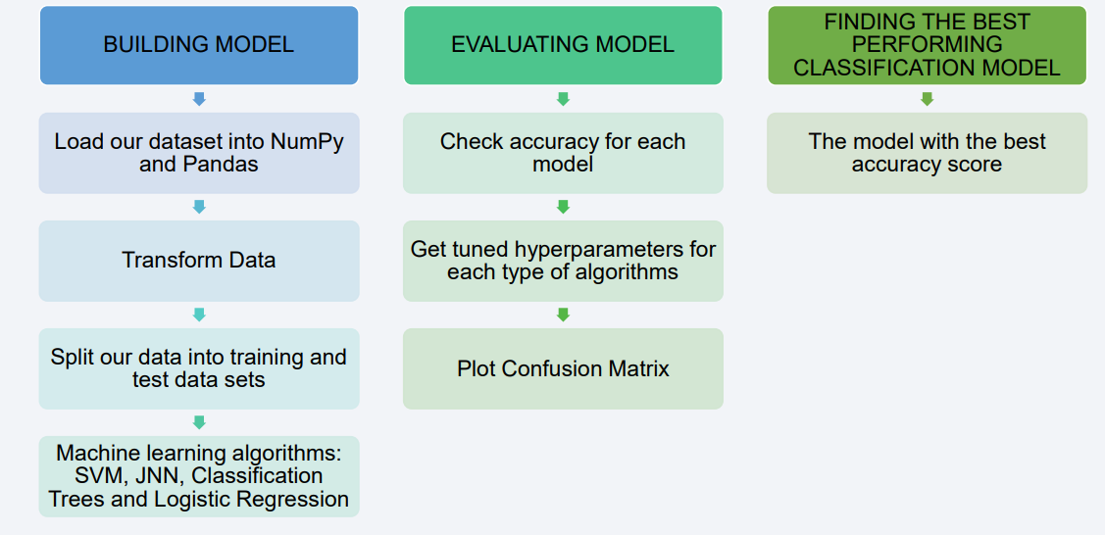
Predictive Analysis (Classification)
Perform exploratory Data Analysis and determine Training Labels
https://github.com/Meiluv/phap

Slide 16
Results
Exploratory data analysis results
Interactive analytics demo in screenshots
Predictive analysis results

Slide 17

Section 2

Slide 18
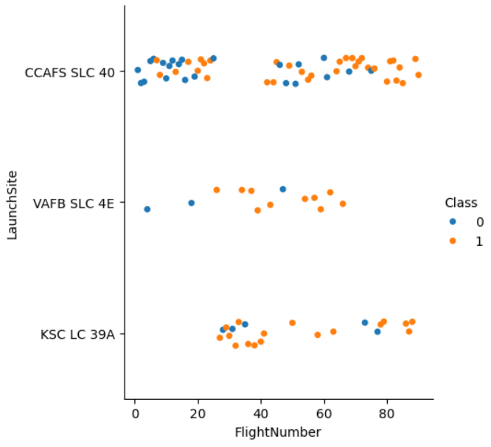
Flight Number vs. Launch Site
Show a scatter plot of Flight Number vs. Launch Site
Show the screenshot of the scatter plot with explanations

Slide 19
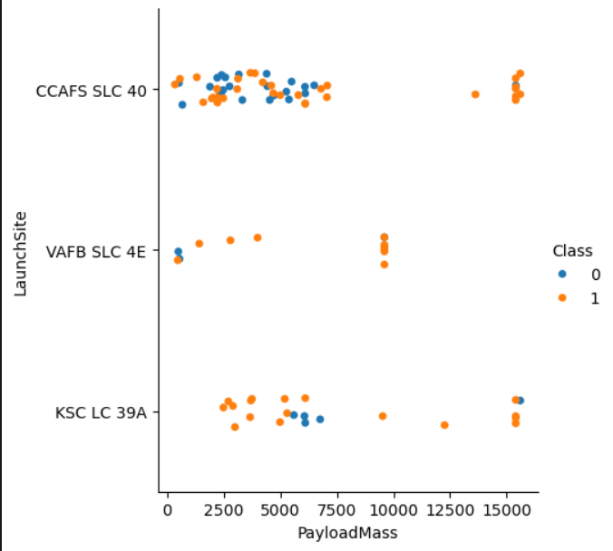
Payload vs. Launch Site
Show a scatter plot of Payload vs. Launch Site
Show the screenshot of the scatter plot with explanations

Slide 20
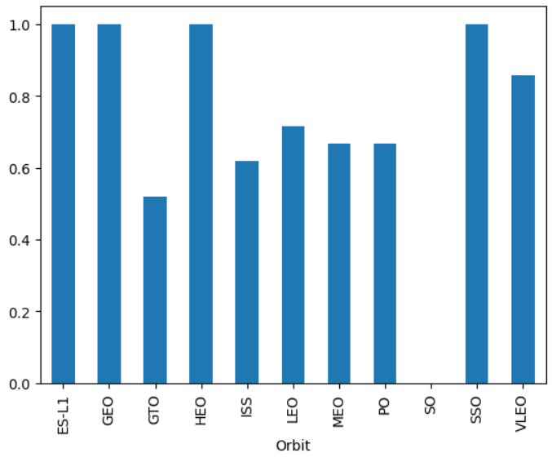
Success Rate vs. Orbit Type
Show a bar chart for the success rate of each orbit type
Show the screenshot of the scatter plot with explanations

Slide 21
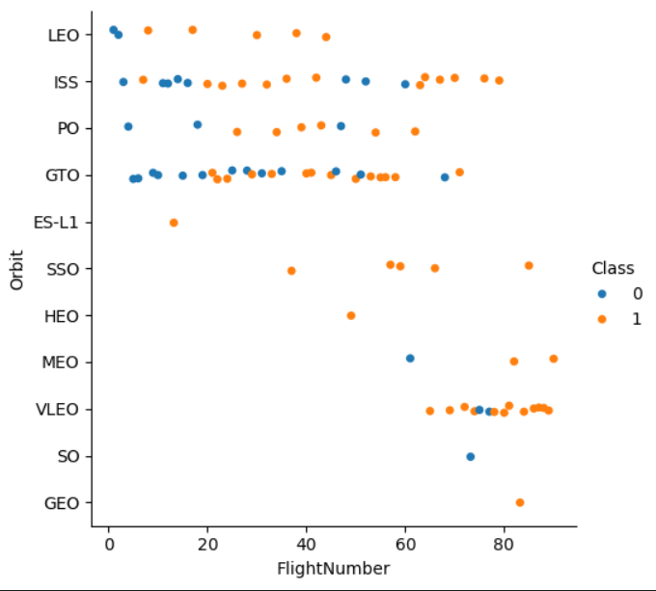
Flight Number vs. Orbit Type
Show a scatter point of Flight number vs. Orbit type
Show the screenshot of the scatter plot with explanations

Slide 22
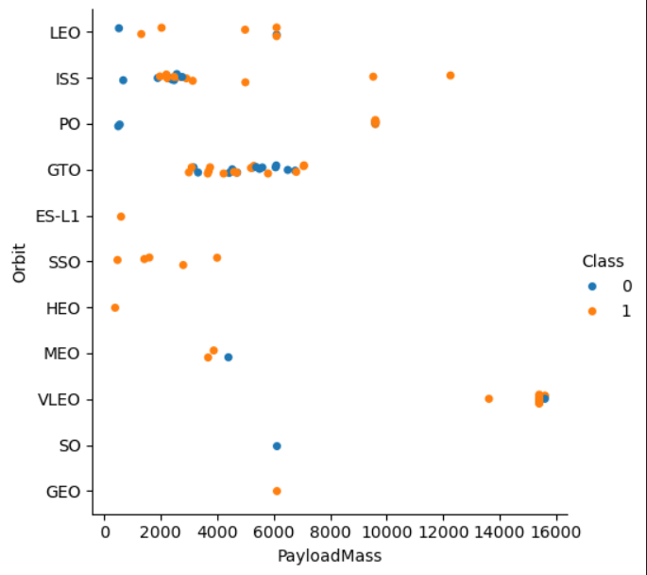
Payload vs. Orbit Type
Show a scatter point of payload vs. orbit type
Show the screenshot of the scatter plot with explanations

Slide 23
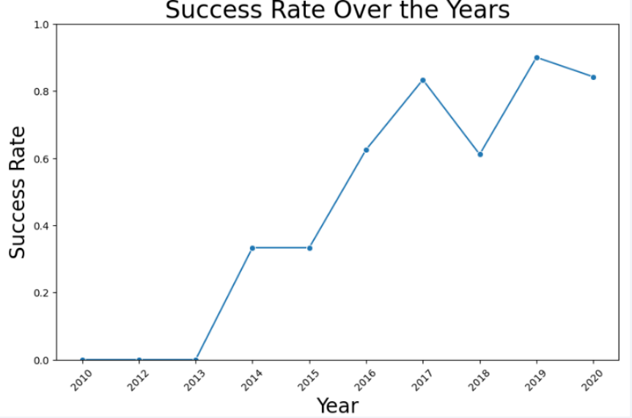
Launch Success Yearly Trend
Show a line chart of yearly average success rate
Show the screenshot of the scatter plot with explanations

Slide 24
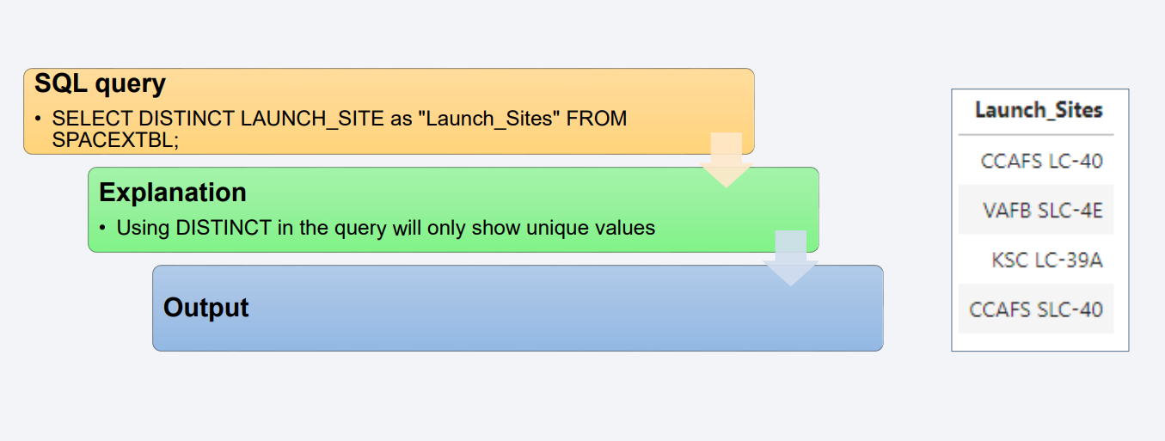
All Launch Site Names

Slide 25
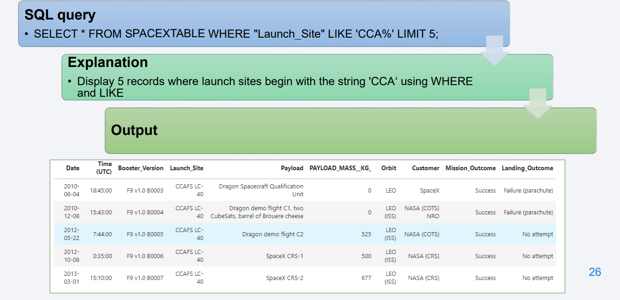
Launch Site Names Begin with 'CCA'

Slide 26
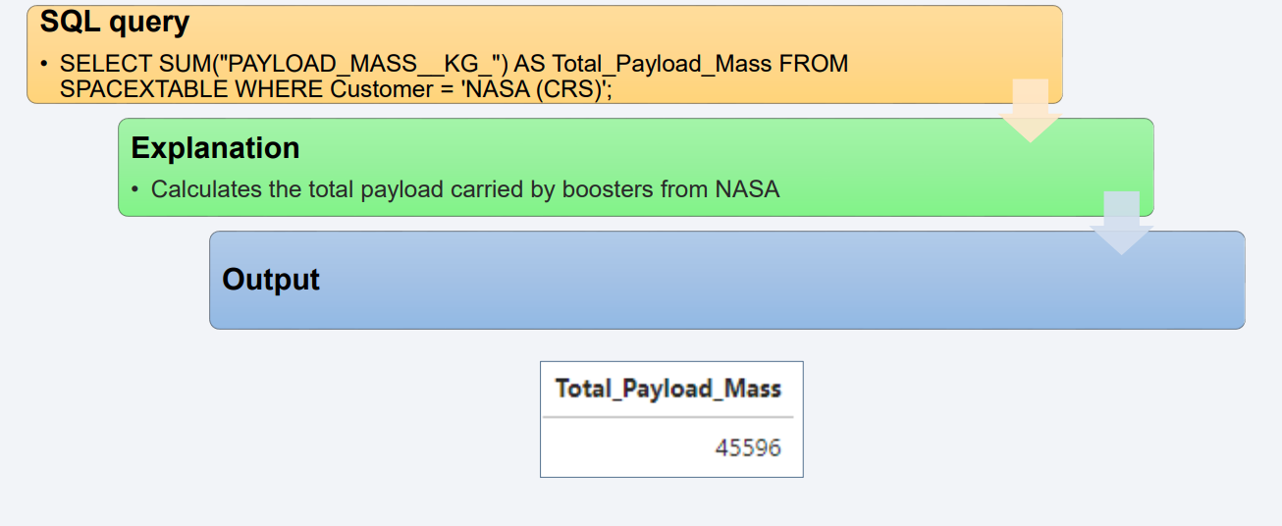
Total Payload Mass

Slide 27
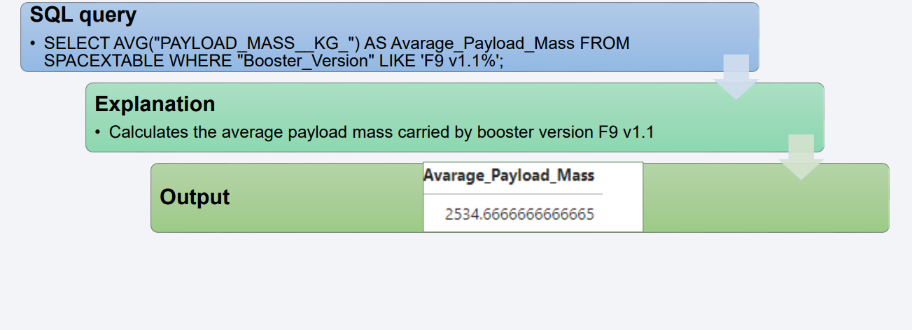
Average Payload Mass by F9 v1.1

Slide 28
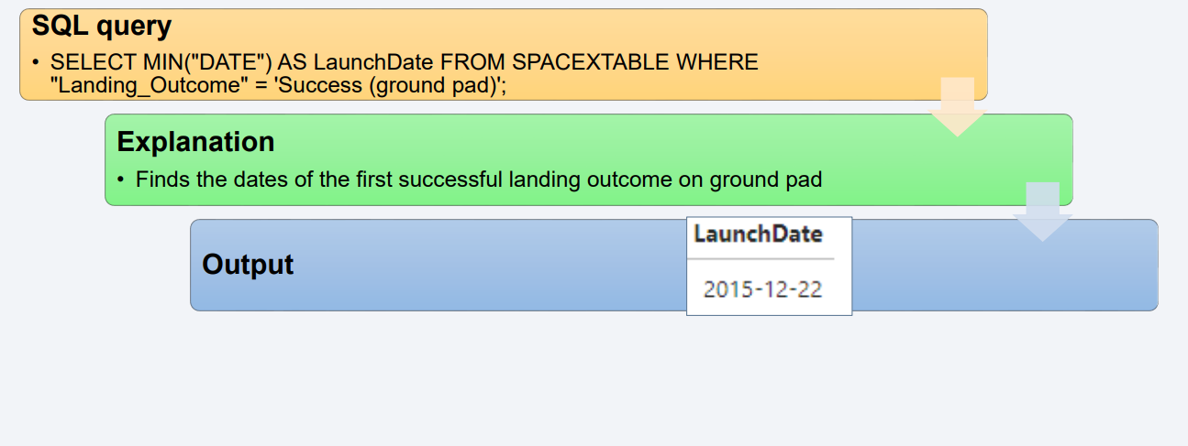
First Successful Ground Landing Date

Slide 29
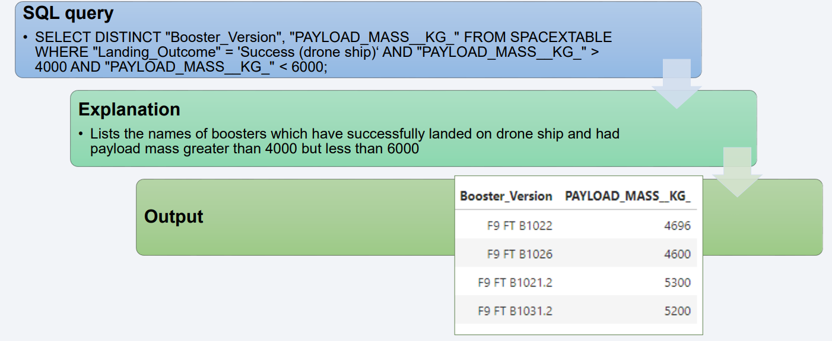
Successful Drone Ship Landing with Payload between 4000 and 6000

Slide 30
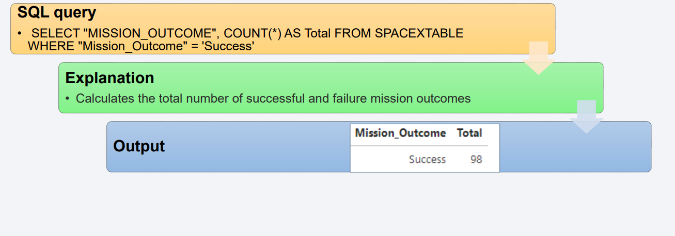
Total Number of Successful and Failure Mission Outcomes

Slide 31
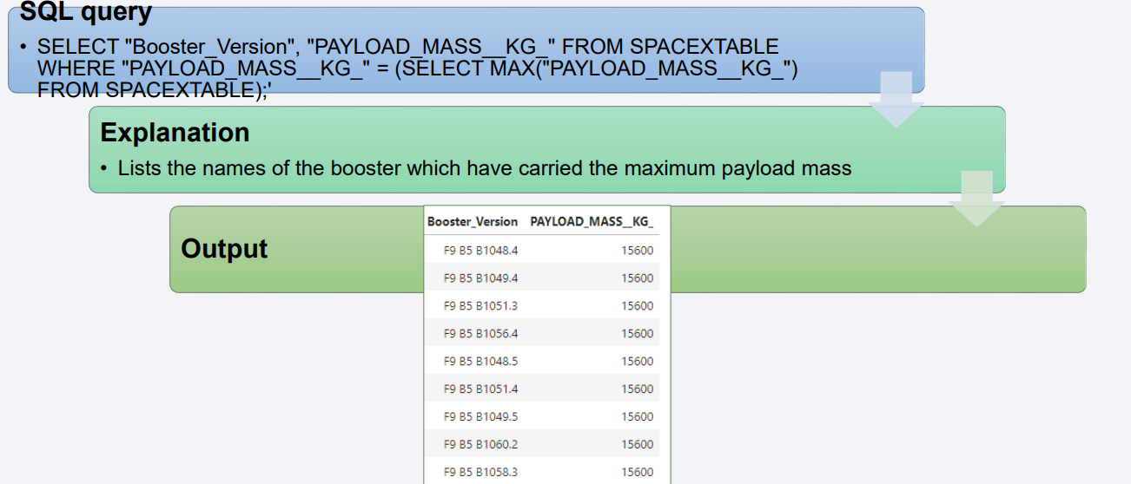
Boosters Carried Maximum Payload

Slide 32
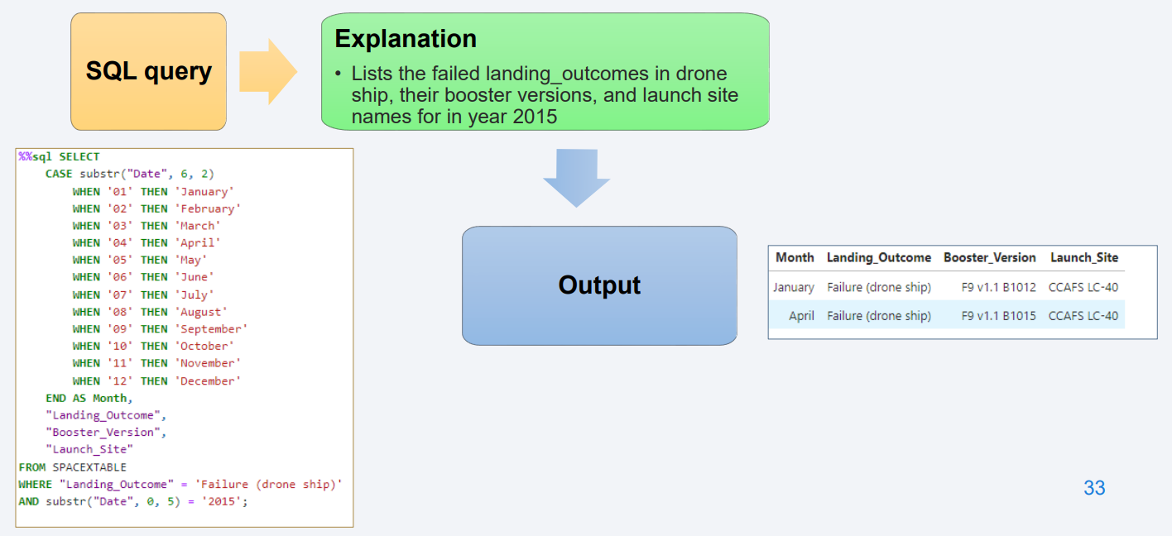
2015 Launch Records

Slide 33
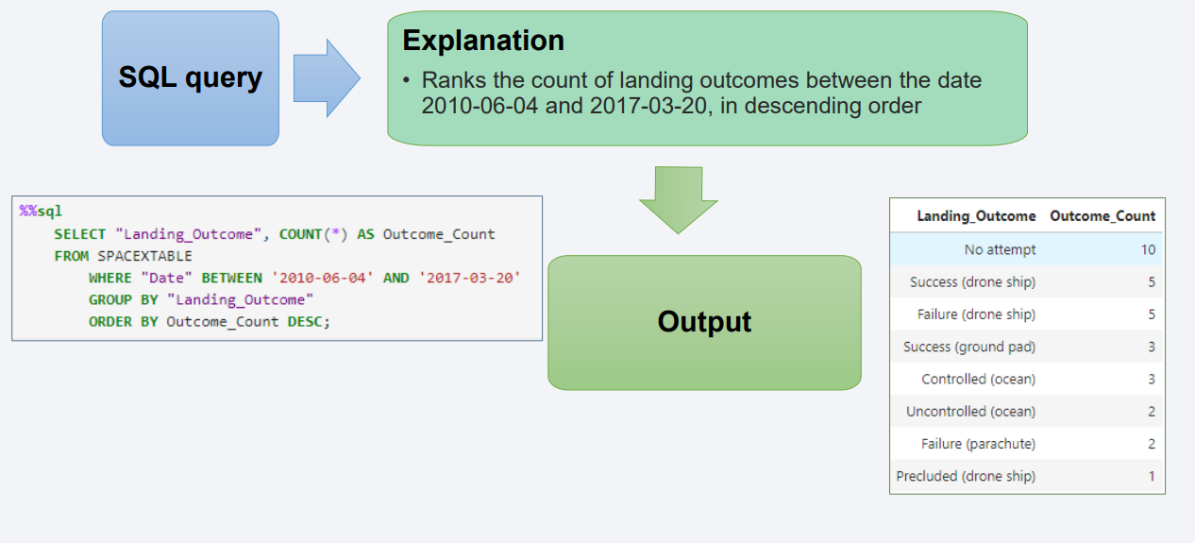
Rank Landing Outcomes Between 2010-06-04 and 2017-03-20

Slide 34

Section 3

Slide 35
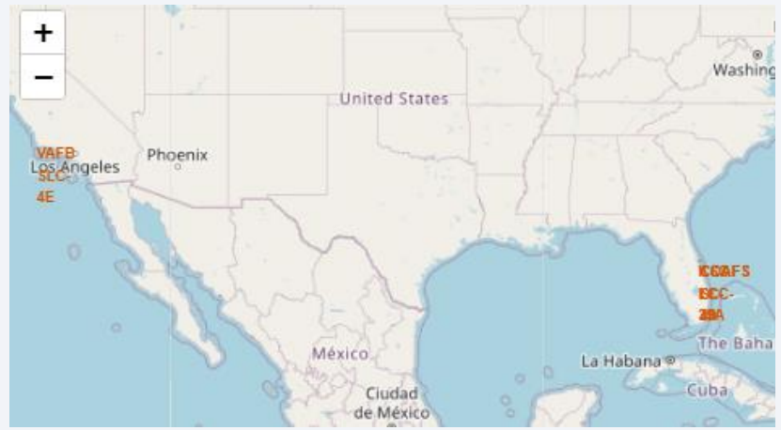
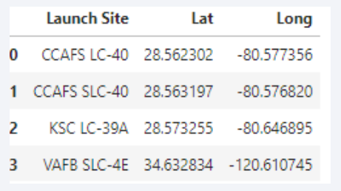
<Folium Map Screenshot 1>
• Location on map using site’s latitude and longitude

Slide 36
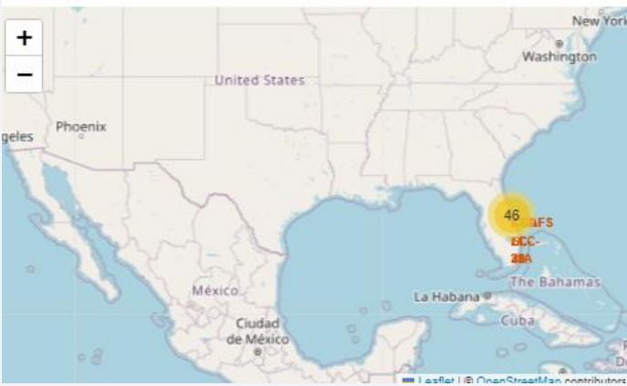
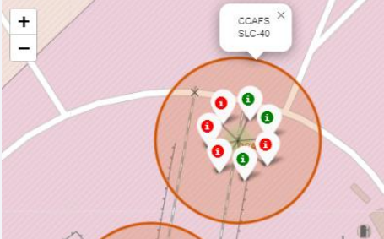
<Folium Map Screenshot 2>
• Marker clusters are use to simplify the map containing many markers with the same coordinate
• The markers display the mission Success or Failure for Falcon 9 first stage landings.
• Image is of CCAFS SLC-40 launch site

Slide 37
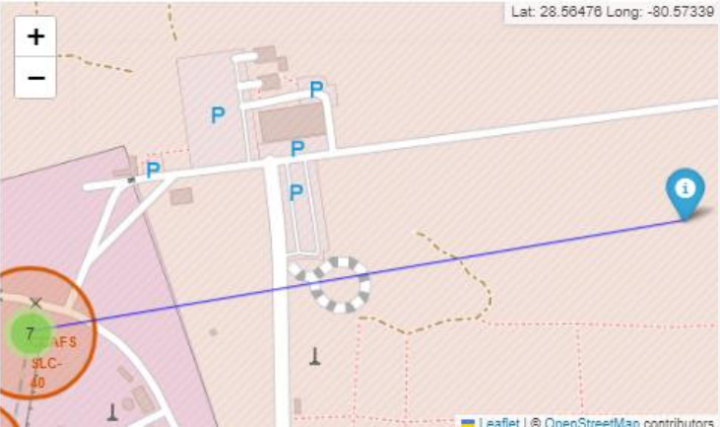
<Folium Map Screenshot 3>
• The generated folium map shows the launch site to its proximities to a coastline and a railway, with distance calculated and displayed

Slide 38

Section 4

Slide 39
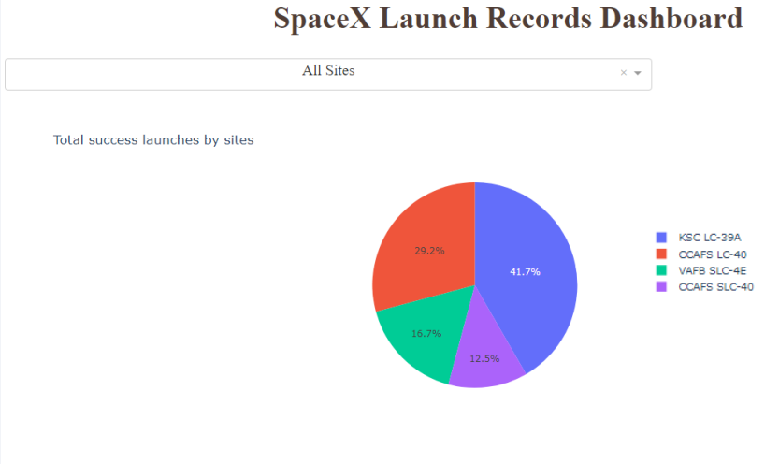
<Dashboard Screenshot 1>
• We have four different launch sites
• KSC LC-39A 41.7%
• CCAFS LC-40 29.2%
• VAFB SLC-4E 16.7%
• CCAFS SLC-40 12.5%

Slide 40
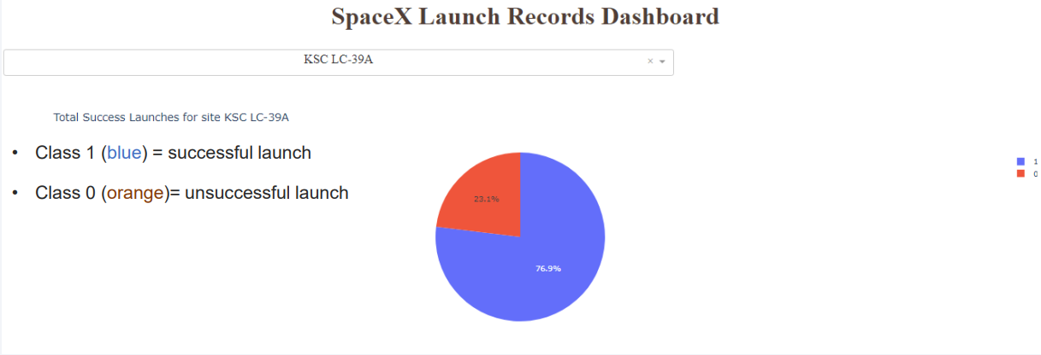
<Dashboard Screenshot 2>
• KSC LC-39A is the launch site with highest launch success ratio
• When in the dropdown a specific launch site is selected, a pie chart is show for the success (class=1) and failed (class=0) lauches.

Slide 41
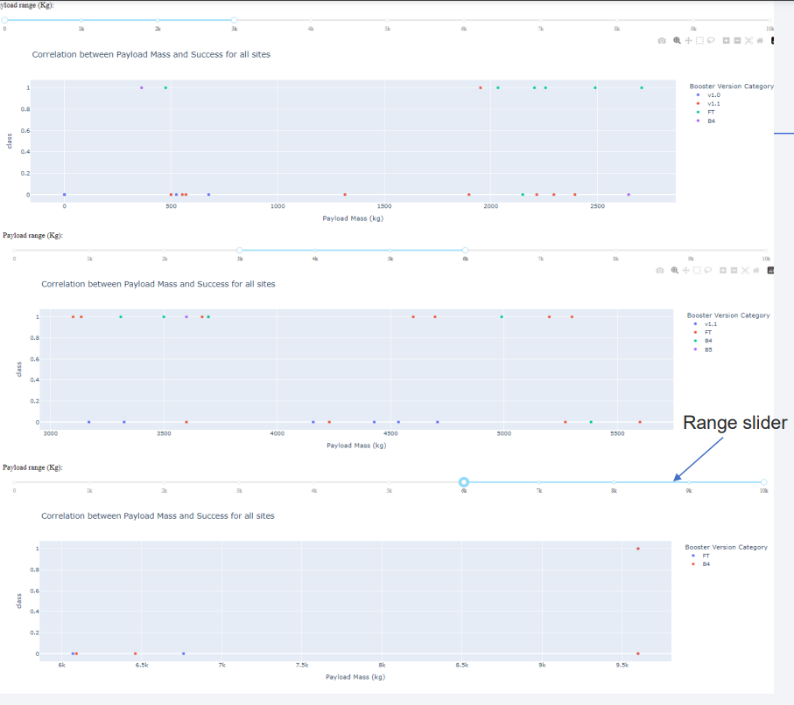
<Dashboard Screenshot 3>
• Scatter plot for all sites with Payload range
• 0-3k
• 3k-6k
• 6k-10k
• Range slider to select different payload range

Slide 42

Section 5

Slide 43
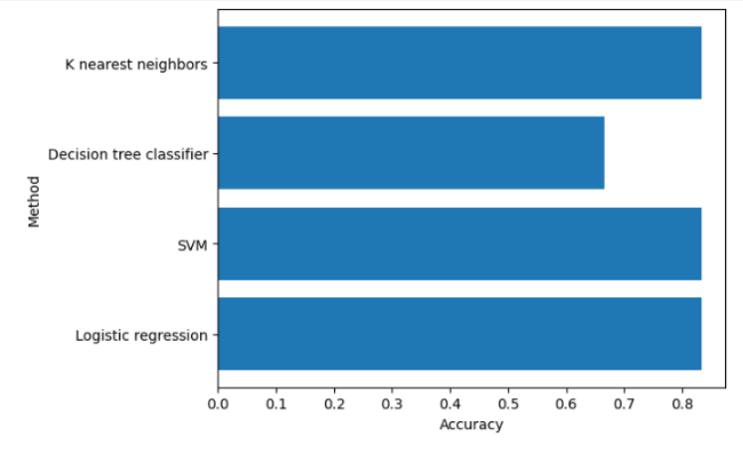
Classification Accuracy
• Bar chart of the accuracy for all built classification models
• The best performing model is: Logistic regression with an accuracy of 0.83
• Decision Tree model performed poorly relative to the other models

Slide 44
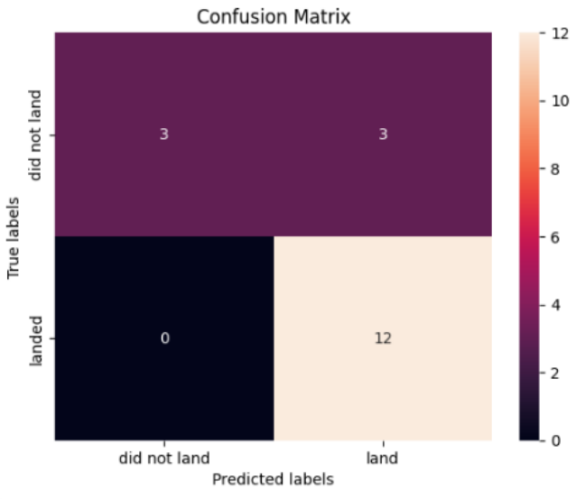
Confusion Matrix
• Visualization of the results using a confusion matrix to assess performance in terms of true positives, false positives, etc .
• The logistic regression can distinguish between the different classes. We see that the problem is false positives.
• True Postive - 12
• False Postive - 3

Slide 45
Conclusions
• The best performing model is: Logistic regression with an accuracy of 0.83
• While the logistic regression model shows good performance with a reasonably high number of true positives, the false positives indicate an area for improvement.
• Success rate varies with launch site.
• This study has provided a comprehensive examination of the data science process, from data gathering to predictive modeling.

Slide 46
Appendix
Include any relevant assets like Python code snippets, SQL queries, charts, Notebook outputs, or data sets that you may have created during this project

Slide 47


